Slide 1
Understanding the Managed Services Model

Slide 2
About Association Management Companies (AMCs)
700+ AMCs globally
180 are AMC Institute members
Represent 2,000 full service managed associations with 2.8 million members
AMC Institute provides the industry’s only accreditation
Notes:
Association management companies, or AMCs, are for-profit businesses that manage associations to help them grow and prosper. They offer the expertise, staffing and resources that allow professional societies, trade groups, not-for-profits and philanthropic organizations to effectively manage day-to-day operations and advance their long-term goals. AMCs deliver high levels of expertise and accountability so that associations can continue to increase their value and relevance to members and achieve measureable results.
AMCs provide their clients with unparalleled flexibility, agility and financial advantages, which makes the AMC model a good alternative for managing many nonprofit organizations.

Slide 3
AMCs play a critical role in growing associations and not-for-profits through our:

Slide 4
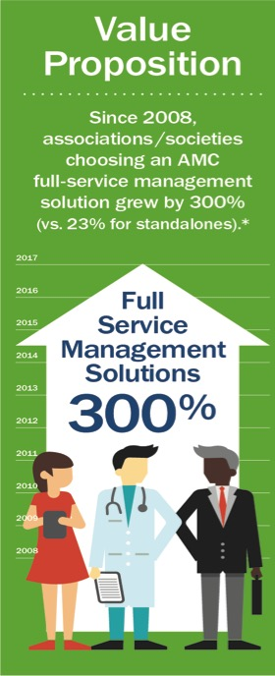
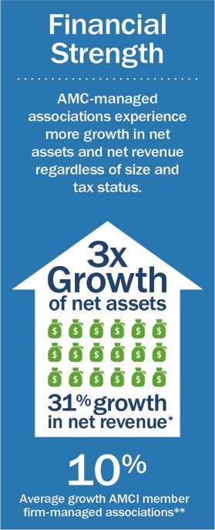
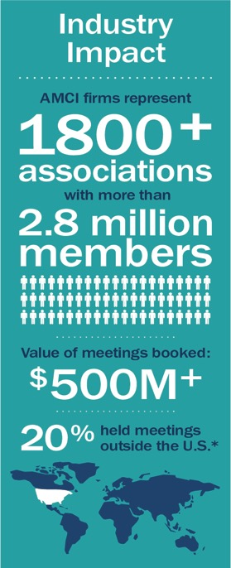

Slide 5
Research-based Support
AMCs drive stronger financial performance
Growth of Net Income, Net Revenue, and Net Assets are stronger for associations using AMCs
AMC-managed associations experience more than 3x the growth in net assets and 31% more growth in net revenue than those that do not use AMCs
12.57%
In general, associations using AMCs have stronger net total income growth than those not using AMCs (2014)
7.61%
Stand-alone
AMC managed
Notes:
In general, using AMCs is associated with stronger financial performance.
Regardless of tax status and budget size, growth in Net Income, Net Revenue, and Net Assets are stronger for associations using AMCs.
On average,

Slide 6
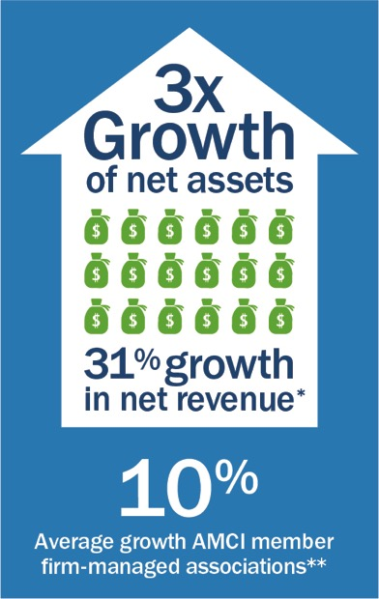
Significantly stronger financial results mean greater benefits for your organization and your members.
Notes:
AMC-managed associations experience more than three times the growth in net assets and 31 percent more growth in net revenue regardless of size and tax status than those that do not use AMCs.

Slide 7
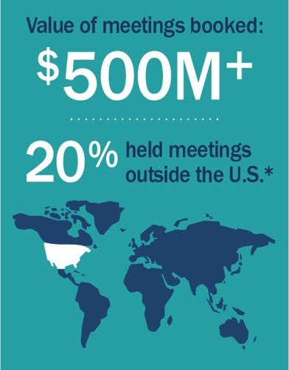
The collective reach, influence, and buying power of our members translate to cost and service efficiencies for our clients.

Slide 8
Financial/Business Benefits
Leverage shared resources - including office space, equipment and technologies
Improved buying power
Reduced business risks
Notes:
Efficiencies derived from leveraging shared resources, including office space, equipment and technologies.
Improved buying power since purchases can be leveraged across multiple clients.
Reduced business risks because an AMC takes on many of the insurance liabilities associated with operating an association.

Slide 9
Operational & Staffing Benefits
Customized staffing and services
Broad spectrum of expertise
Day-to-day and ongoing staff management
Improved staffing and resource allocation
Proven best management practices and best-of-class resources and technologies
Notes:
Staffing and services are customized to meet each individual organization’s needs.
A broad spectrum of expertise covering all the disciplines is required to run an effective association.
The models allows Day-to-day and ongoing staff management, alleviating administrative headaches often faced by association Boards of Directors.
The result is improved staffing and resource allocation, giving each association access to specialized resources – just what you need when you need it.
Our approach ensures your organizations has access to best management practices that we continually test, and review. Same too for best-of-class resources and technologies.

Slide 10
Long-Term Benefits
Greater member satisfaction
Boards enabled to maintain focus on mission and strategy
Integration of innovative strategies and ideas, stemming from working with multiple industry organizations
Scalability to accommodate organizational growth or contraction over time
Notes:
Full service management means that you can focus on the outcomes
Greater member satisfaction resulting from the professionalism and responsiveness of staff who understand the importance of placing members first
Freedom from daily operations that allows Boards to maintain their focus on mission and strategy.
Integration of innovative strategies and ideas, stemming from the input and experience AMCs gain from working with multiple industry and professional organizations.
Scalability to accommodate organizational growth or contraction over time.

Slide 11
The AMC model balances best practices, business acumen, and non-profit sector expertise to elevate an associations value and potential.

Slide 12
Three Nonprofit Staffing Models
Volunteer Led
Employed Staff
AMC Managed
Notes:
Volunteer-led Pros: Strong commitment to organization; understanding of the organization's mission; Lower direct costs
Cons: Limited time availability; Not experts at nonprofit organization management and operations; Leadership turnover creates inconsistencies
Potential for conflicts of interest
Employed staff – or stand alone, Pros: 00% "ownership" of all paid staff and association resources; Good opportunity for staff continuity
Cons: High overhead costs and long-term commitments (e.g. office space, equipment, operating systems, furniture); Possible challenges in staffing key positions given competitive compensation costs for highly qualified, full-time staff; Risks associated with being an employer - ;requires more leadership time on administrative, operational functions
AMC – Pros: Experts in association management, operations, including accredited operations for some AMCs; Lower overhead; Expertise in multiple disciplines; Flexible staffing in times of growth or downsizing; Eliminates many typical legal risks associated with employee management; Easily accessible knowledge, experience from other associations; Continuity
Cons: Associations sometimes outgrow their AMC's capabilities; Specific industry knowledge/expertise sometimes must be developed or acquired

